Slide 1
T
TALENTTRACE AI
TalentTrace AI
Evidence-led recruitment
From job-specific CV screening to reviewed interviews and traceable assessment
Presented by Md. Shafi Mahmud
AI Trainee Programme / BJIT final project / October 2026
01 / 18
Notes:
Presenter: Md. Shafi Mahmud. Trainer topic 1. TalentTrace AI is a recruiter workspace for job-specific CV screening, reviewed interviews and traceable assessment. The recruiter makes hiring decisions. Do not claim complete BID compliance, verified fairness or production readiness.
Evidence reviewed through 28 October 2026. Slides revised 29 October 2026.

Slide 2
T
TALENTTRACE AI
CONTEXT
Project overview
One connected workflow across three stages of hiring.
01
02
03
PRE-INTERVIEW
DURING INTERVIEW
POST-INTERVIEW
Define a role, ingest CVs, extract information, score and rank applicants.
Conduct a secure browser interview and capture structured dialogue.
Analyse Q&A evidence and produce a recruiter-reviewable assessment.
POSITIONING
The AI supports the recruiter; the recruiter retains the final judgment.
AI Trainee Programme / BJIT final project / October 2026
02 / 18
Notes:
Trainer topic 2. Purpose: reduce fragmented hiring evidence by connecting the job profile, CV requirements, reviewed interview and assessment. Each optional processing stage has its own authorization and evidence boundary.
Evidence reviewed through 28 October 2026. Slides revised 29 October 2026.

Slide 3
T
TALENTTRACE AI
WHY IT MATTERS
Problem statement
Hiring volume and fragmented evidence make consistent assessment difficult.
High CV volume
Inconsistent judgments
THE DESIGN RESPONSE
Reviewing every application manually is slow and difficult to scale.
Different reviewers may apply different standards to similar candidates.
Structured inputs
→
Unstructured interviews
Opaque decisions
Explainable analysis
Interview evidence can remain in scattered notes instead of searchable records.
Scores and recommendations are hard to defend without traceable sources.
→
Human review
AI Trainee Programme / BJIT final project / October 2026
03 / 18
Notes:
Trainer topic 3. These are the project problem assumptions, not measured claims about hiring throughput or bias reduction.
Evidence reviewed through 28 October 2026. Slides revised 29 October 2026.

Slide 4
T
TALENTTRACE AI
SUCCESS CRITERIA
Project objectives
Intended outcomes. Acceptance results and remaining gaps appear later in this deck.
01
Reduce manual screening effort
Screen and rank a CV batch against a job profile.
02
Increase consistency
Use saved, reviewable criteria and a scoring breakdown.
03
Structure interview content
Capture speaker-labelled, timestamped turns.
04
Make assessments defensible
Link conclusions to CV pages and interview segments.
05
Support faster decisions
Bring pre- and post-interview evidence into one report.
AI Trainee Programme / BJIT final project / October 2026
04 / 18
Notes:
Trainer topic 4. The five rows describe objectives, not certified BID completion. No independent B1-B5 numbering is asserted here.
Evidence reviewed through 28 October 2026. Slides revised 29 October 2026.

Slide 5
T
TALENTTRACE AI
CORE F1–F6 + INNOVATION
Key functionalities
Implemented capabilities with clearly identified acceptance boundaries.
F1
CV screening & ranking
F2
Weighted candidate scoring
F3
Live video interview
Groq-assisted extraction, OCR, job-specific comparison.
Criteria, saved scores, breakdown and evidence.
Recruiter/candidate access, scoped LiveKit media.
Real synthetic tests
Real synthetic tests
2-party Cloud verified
F4
Speech transcription
F5
Q&A evaluation
F6
Consolidated report
Role-labelled turns, consent and optional storage.
Answer quality, question pairing, requirement coverage.
CV evidence plus authorized interview findings.
Live browser STT partial
Synthetic model-double
Synthetic report / print verified
F11 | DYNAMIC INTERVIEWER CO-PILOT
Recruiter-only LangGraph suggestions; fake-STT browser lifecycle PASS. Real AssemblyAI chain not yet verified.
AI Trainee Programme / BJIT final project / October 2026
05 / 18
Notes:
Trainer topic 5. Real synthetic provider tests, offline component tests and actual browser model-double tests have different scopes. F3 media passed; complete current F4 recognized/stored speech feeding real F5/F11 remains unverified.
Evidence reviewed through 28 October 2026. Slides revised 29 October 2026.
Repository source: README.md at release c4e8c90237fb5157e31d69706dc70913ffd25771
Repository source: docs/final_submission_audit_20261028.md at release c4e8c90237fb5157e31d69706dc70913ffd25771

Slide 6
T
TALENTTRACE AI
SYSTEM DESIGN
System architecture
Application components and explicit data-processing boundaries.
USER LAYER
API + SECURITY
AI ORCHESTRATION
PERSISTENCE
React + TypeScript
FastAPI + Pydantic
LangGraph
PostgreSQL
Recruiter dashboard
Candidate invitation UI
Video interview controls
Auth / role isolation
Job & application services
Consent and privacy gates
Stateful screening
Q&A analysis
F11 bounded co-pilot
Jobs, criteria, scores
Invitations, transcripts
Assessment evidence
Groq
LiveKit
AssemblyAI
Discord / Telegram / Google
JD + CV inference
Real-time media
Synthetic STT trial
Separate publishing / intake adapters
Third-party calls only when configured and authorized • synthetic data used in evaluation
AI Trainee Programme / BJIT final project / October 2026
06 / 18
Notes:
Trainer topic 6. This is a logical component view, not a physical connection topology. React calls the same-origin nginx proxy and authenticated FastAPI APIs. FastAPI owns PostgreSQL/private file services and invokes LangGraph. The browser connects directly to LiveKit for media using short role-scoped grants issued by the backend. Browser AudioWorklet sends role-authenticated PCM to FastAPI; backend STT connects to local Faster-Whisper or separately consented AssemblyAI. Discord uses MCP webhook transport, Telegram uses Bot API, and Google Forms/Drive uses a bounded trusted intake bridge. Optional integrations require explicit configuration and authorization.
Evidence reviewed through 28 October 2026. Slides revised 29 October 2026.
Repository source: README.md at release c4e8c90237fb5157e31d69706dc70913ffd25771
Repository source: docs/architecture/application_overview.md at release c4e8c90237fb5157e31d69706dc70913ffd25771
Repository source: docs/task4_assemblyai_live_20261027.md at release c4e8c90237fb5157e31d69706dc70913ffd25771

Slide 7
T
TALENTTRACE AI
ENGINEERING CHOICES
Technology stack
Tools were selected for explicit orchestration, testability and local reproducibility.
FRONTEND
React, TypeScript, Vite
BACKEND
Python, FastAPI, Pydantic
Browser UI, responsive workflow, typed API views
APIs, contracts, access control and validation
AGENTIC AI
LangGraph, Groq API
DATABASE
PostgreSQL + pgvector
Explicit state transitions + approved free-tier inference
Persistent jobs, CV evidence, scoring and transcripts
LIVE INTERVIEW
LiveKit / WebRTC
TRANSCRIPTION
AssemblyAI; existing local Whisper path
Scoped real-time audio and video transport
Speaker-labelled speech pipeline; live completion pending
DOCUMENTS
PyMuPDF + Tesseract
DELIVERY
Docker Compose, Git, GitHub
PDF text extraction and scanned-page OCR
Versioned services, reproducible setup, traceable commits
AI Trainee Programme / BJIT final project / October 2026
07 / 18
Notes:
Trainer topic 7. F11 is model-free despite the general LangGraph/Groq entry. Groq serves approved JD/CV and configured evaluation paths. Faster-Whisper is local optional STT; AssemblyAI is a separate cloud path. Telegram is Bot API, never Telegram MCP.
Evidence reviewed through 28 October 2026. Slides revised 29 October 2026.
Repository source: README.md at release c4e8c90237fb5157e31d69706dc70913ffd25771

Slide 8
T
TALENTTRACE AI
END-TO-END JOURNEY
Workflow / process flow
Connected recruiter journey; the full live F4-to-F5/F11 path remains partial.
1
2
3
4
Create and review job
Add candidate CVs
Screen and review
Select and book
Groq JD → stable Job Reference
Upload / approved imports; OCR
Groq analysis + weighted evidence
Human review → scheduled slot
5
6
7
Conduct interview
Interpret interview
Review assessment
LiveKit recruiter + candidate
Consented STT → grounded Q&A
CV + interview evidence → report
F11 offers optional provisional follow-ups. Recruiters review evidence and make the hiring decision.
AI Trainee Programme / BJIT final project / October 2026
08 / 18
Notes:
Trainer topic 8. This flow describes implemented stages, not an accepted end-to-end live-provider demonstration. During the viva, show saved evidence and disclose gaps before any provider-dependent stage.
Evidence reviewed through 28 October 2026. Slides revised 29 October 2026.
Repository source: docs/final_submission_audit_20261028.md at release c4e8c90237fb5157e31d69706dc70913ffd25771

Slide 9
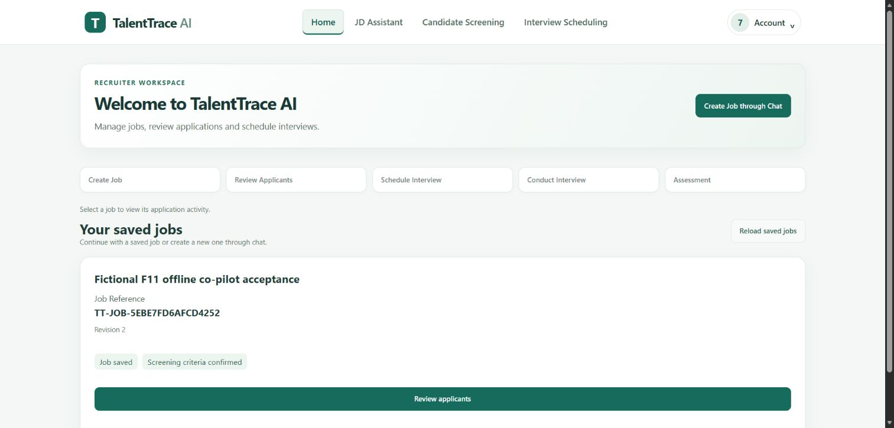
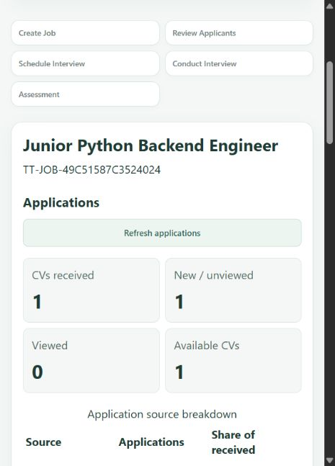
T
TALENTTRACE AI
CAPTURED APPLICATION SCREENS
UI demonstration: Home and applications
Actual local browser captures. The desktop and mobile examples use separate synthetic fixtures.
Saved jobs and a clear next action
One approved Google import
1 received / 1 new / 1 available
Snapshot at import, not automatic sync
AI Trainee Programme / BJIT final project / October 2026
09 / 18
Notes:
Trainer topic 9. These are captured application screens, not UI mockups. Left: retained Task 7 browser review. Right: the single explicitly approved Google Form import. Different synthetic jobs appear in the two examples. No new provider operation ran to make this deck.
Evidence reviewed through 28 October 2026. Slides revised 29 October 2026.
Repository source: docs/task7_ui_remote_checkpoint_20261027.md at release c4e8c90237fb5157e31d69706dc70913ffd25771
Repository source: docs/google_single_import_20261028.md at release c4e8c90237fb5157e31d69706dc70913ffd25771

Slide 10
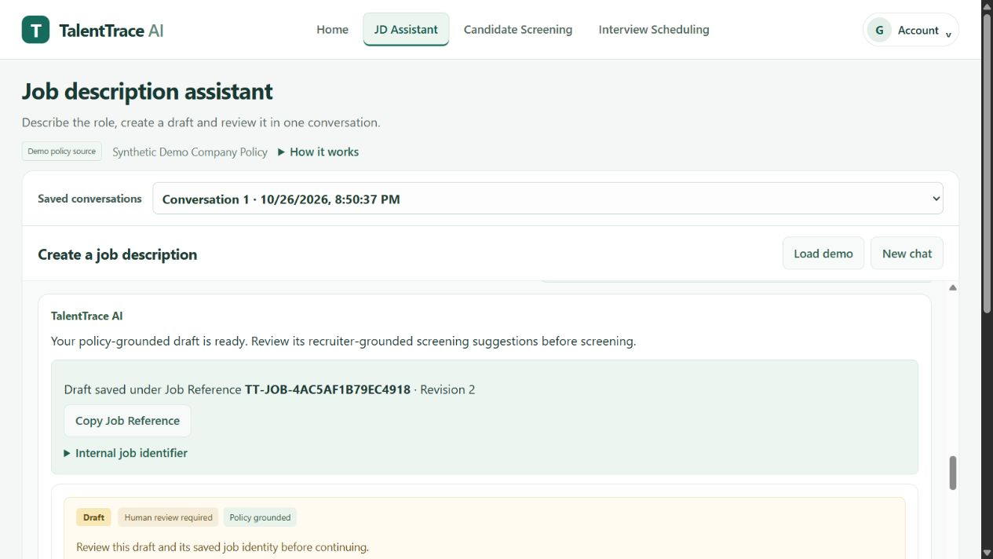
TALENTTRACE AI
CAPTURED APPLICATION SCREENS
UI demonstration: saved JD refinement
Actual Groq-demo browser capture after refresh. The saved job remains at revision 2.
What to explain
A conversation refines the existing saved job.
Job Reference remains stable.
Revision changes trigger renewed criteria review.
Historical capture before the final chat-layout polish
BJIT final project / Evidence through 28 October 2026
10 / 18
Notes:
Trainer topic 9, continued. This screenshot is historical real Groq JD evidence, not a newly executed model call. The screen is from the retained pre-final-layout runtime. Demonstrate the Job Reference and revision rather than promising identical current screen geometry.
Evidence reviewed through 28 October 2026. Slides revised 29 October 2026.
Repository source: docs/task2_acceptance_20261026.md at release c4e8c90237fb5157e31d69706dc70913ffd25771
Repository source: docs/jd_chat_publishing_20261028.md at release c4e8c90237fb5157e31d69706dc70913ffd25771

Slide 11
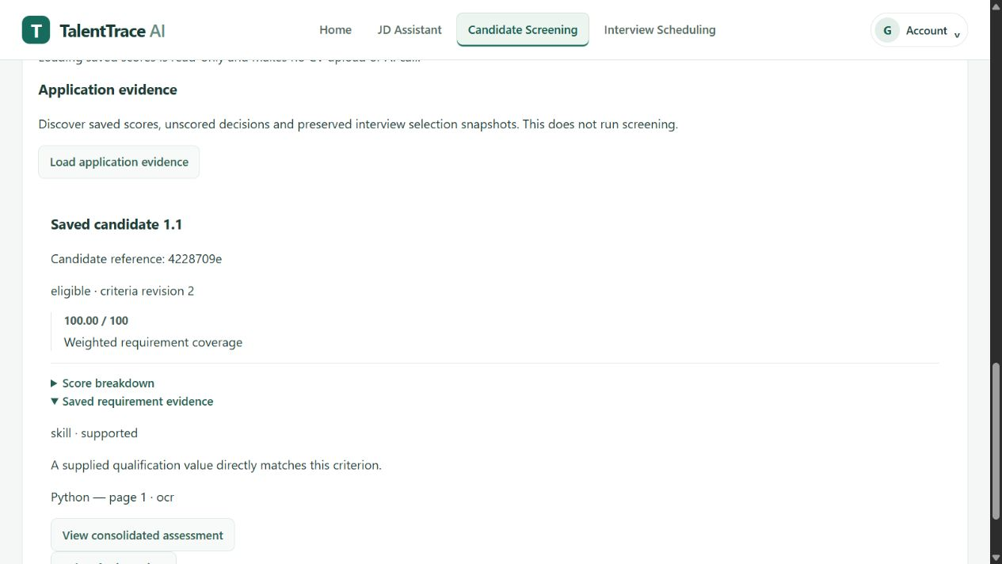
TALENTTRACE AI
CAPTURED APPLICATION SCREENS
UI demonstration: screening evidence
Saved synthetic OCR result in the actual recruiter application. This is one example, not full-batch coverage.
Evidence before selection
Saved criteria revision
Requirement coverage
Source page and OCR provenance
Recruiter review remains required
An unscored result is not a zero score
BJIT final project / Evidence through 28 October 2026
11 / 18
Notes:
Trainer topic 9, continued. Actual saved synthetic Groq/OCR result. The displayed 100/100 belongs only to this fixture and is not a quality, fairness or batch benchmark. Uncertain, excluded and failed records are distinct.
Evidence reviewed through 28 October 2026. Slides revised 29 October 2026.
Repository source: docs/task2_acceptance_20261026.md at release c4e8c90237fb5157e31d69706dc70913ffd25771
Repository source: docs/f1_f2_deadline_acceptance.md at release c4e8c90237fb5157e31d69706dc70913ffd25771

Slide 12
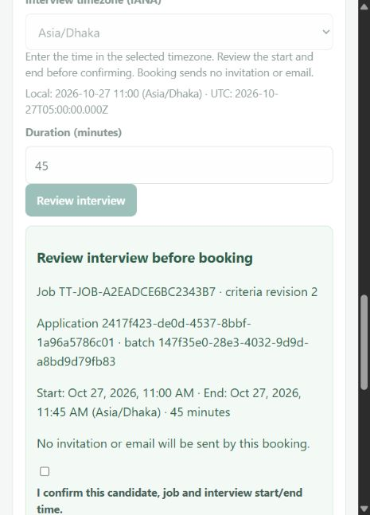
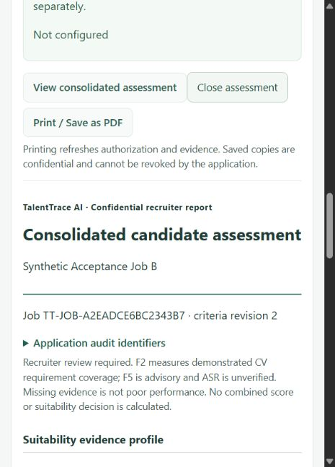
TALENTTRACE AI
CAPTURED APPLICATION SCREENS
UI demonstration: booking and assessment
Actual synthetic application captures. Booking review and consolidated evidence are separate decisions.
Review before booking
Assessment and print
What these screens show
Review date, start/end, timezone and duration.
Booking sends no automatic email.
The report separates CV evidence from available interview evidence.
No invented combined hiring score.
Historical synthetic fixtures. No new booking or email.
BJIT final project / Evidence through 28 October 2026
12 / 18
Notes:
Trainer topic 9, continued. Left is a historical unconfirmed review panel, not proof of a newly booked interview. Separate browser booking/reload acceptance is recorded. Right shows the CV-only report and print access. Combined F6 and comparison used a labelled F5 model double in separate accepted evidence.
Evidence reviewed through 28 October 2026. Slides revised 29 October 2026.
Repository source: docs/trainer_feature_status_20261026.md at release c4e8c90237fb5157e31d69706dc70913ffd25771
Repository source: docs/f5_f6_final_acceptance_20261027.md at release c4e8c90237fb5157e31d69706dc70913ffd25771

Slide 13
T
TALENTTRACE AI
ENGINEERING LESSONS
Challenges and solutions
Recorded engineering problems, targeted fixes and limitations.
JD refinement ambiguity
Grounding/negation rule could reject valid changes.
Targeted validation fix; real Groq revision 1→2.
Resolved in synthetic JD test
Scanned / mixed PDFs
Image-only pages are not ordinary PDF text.
Tesseract OCR integrated into evidence-backed screening.
Verified on synthetic PDFs
AI provider configuration
Provider-disabled demo hid implemented Groq paths.
Separate enabled runtime; explicit cloud-data consent.
Groq synthetic flow verified
Interview integration
LiveKit/observer, consent and startup boundaries were fragile.
Working Cloud F3; real F4 audio reached provider but produced no recognized captions.
Media verified; combined STT chain partial
External integrations / privacy
Imports, posts and biometric experiments need distinct evidence.
One approved Google import and Discord post; face identity unverified.
Scoped imports/posts only
AI Trainee Programme / BJIT final project / October 2026
13 / 18
Notes:
Trainer topic 10. Do not attribute the self-hosted failure to ICE or the latest zero-caption result to WAV selection without causal evidence. The new selection-race fix passed offline tests, while historical root cause remains unknown. One Google intake and one private Discord post are real but narrowly scoped successes.
Evidence reviewed through 28 October 2026. Slides revised 29 October 2026.
Repository source: docs/deadline_closure_20261028.md at release c4e8c90237fb5157e31d69706dc70913ffd25771
Repository source: docs/google_single_import_20261028.md at release c4e8c90237fb5157e31d69706dc70913ffd25771
Repository source: docs/jd_chat_publishing_20261028.md at release c4e8c90237fb5157e31d69706dc70913ffd25771

Slide 14
T
TALENTTRACE AI
HONEST PROGRESS
Current status and future improvements
Evidence through 28 October 2026. Separate successful trials do not prove the full live chain.
CURRENT VERIFIED EVIDENCE
PARTIAL / UNVERIFIED
NEXT IMPROVEMENTS
Real Groq JD refinement and saved revision
N1: 20 parsed, 4 numeric scores, one terminal rate-limit failure
Complete candidate-associated erasure
One approved Google CV import; Discord post
F4: latest live browser produced zero recognized captions
Verify a complete 20-CV provider run
F3 two-person Cloud media (generated A/V)
F5: model double; F11: fake-STT browser acceptance
Complete real browser F4-to-F5/F11 acceptance
F6 evidence report and browser PDF export
N19 broad deletion and N21 second-machine proof remain partial
Verify a second clean machine and approved remote HTTPS setup
AI Trainee Programme / BJIT final project / October 2026
14 / 18
Notes:
Current limitations: N1 historical run 20 parsed, 19 decisions, four numeric scores, 11 eligible-unscored, four excluded, one terminal 429 in 449.09 seconds. N19 general deletion is incomplete. N21 same-host Docker passed, second machine not proved. F4 separate real API and offline browser successes do not prove real browser recognized/stored transcript. F5 current browser uses a deterministic model double. F11 uses fake STT. Prioritize candidate-associated erasure and bounded acceptance work.
Evidence reviewed through 28 October 2026. Slides revised 29 October 2026.
Repository source: docs/deadline_closure_20261028.md at release c4e8c90237fb5157e31d69706dc70913ffd25771

Slide 15
T
TALENTTRACE AI
AGENTIC ARCHITECTURE
LangGraph beyond a single LLM call
Two separate graphs serve different decisions, each with explicit validation and abstention.
F5 • POST-INTERVIEW EVALUATION
F11 • LIVE RECRUITER CO-PILOT
Pair Q&A
Validate context
Speaker-attributed, finalized transcript
Run identity, consent and permissions
Map requirements
Assemble dialogue
Confirmed job criteria revision
Trusted role/time caption events
Retrieve reference
Track exploration
Curated local Python documentation
Answered vs uncovered requirements
Assess + validate
Select + validate
Grounding checks; bounded abstention
Provisional follow-up or abstain
AI Trainee Programme / BJIT final project / October 2026
15 / 18
Notes:
Supplemental explanation. F5 uses pairing, requirement mapping, curated reference retrieval, assessment and validation. F11 is model-free and only uses trusted finalized F4 events with two-party assistant consent, recruiter-only projection and abstention. Current F11 actual browser acceptance used simulated STT/media; no own transcript or suggestion persistence.
Evidence reviewed through 28 October 2026. Slides revised 29 October 2026.
Repository source: docs/f11_final_acceptance_20261027.md at release c4e8c90237fb5157e31d69706dc70913ffd25771
Repository source: docs/f5_f6_final_acceptance_20261027.md at release c4e8c90237fb5157e31d69706dc70913ffd25771

Slide 16
T
TALENTTRACE AI
SECURITY & ETHICS
Privacy and human oversight
Recruitment evidence is sensitive; absence of evidence must never become a negative hiring score.
Authorization and scope
Separate consent
Recruiter/job/interview ownership checks; candidate one-use invitation; no cross-owner evaluation.
External Groq, caption processing, transcript storage and F11 assistant have independent gates.
Responsible scoring
Deletion boundary
Job-relevant evidence and source-linked requirements. Unscored is not zero; missing F5 is not failure.
Transcript withdrawal is implemented, but broad candidate-associated N19 deletion remains partial.
Use synthetic examples in demonstrations. Keep private CVs, transcripts, tokens and recordings outside Git.
AI Trainee Programme / BJIT final project / October 2026
16 / 18
Notes:
Supplemental privacy discussion. Transcript withdrawal/deletion is not full N19 candidate erasure. Exported reports and external copies have separate retention. Missing evidence must not become an adverse numeric score.
Evidence reviewed through 28 October 2026. Slides revised 29 October 2026.
Repository source: README.md at release c4e8c90237fb5157e31d69706dc70913ffd25771
Repository source: docs/deadline_closure_20261028.md at release c4e8c90237fb5157e31d69706dc70913ffd25771

Slide 17
T
TALENTTRACE AI
DOCKER HANDOFF
Docker and reviewer setup
A clean checkout can run the provider-disabled application after explicit setup; full-feature parity is not verified.
Reviewer checkout (access to private repository required)
git clone --branch v1.0-final --single-branch https://github.com/shafi-mahmud/TalentTrace-AI.git
cd TalentTrace-AI
Baseline setup
Optional integrations
New private config, fresh volume, migration 0017, Compose startup and synthetic recruiter provisioning.
Groq needs private key + BGE model cache. LiveKit, AssemblyAI, F5 and F11 need separate readiness/consent.
AI Trainee Programme / BJIT final project / October 2026
17 / 18
Notes:
Current verified release: c4e8c90237fb5157e31d69706dc70913ffd25771, annotated tag v1.0-final. Follow README commands, verify a new empty owned database before migration, and never reuse a preserved database URL. Same-host disposable Docker proof passed. Second clean-machine/full-feature operation is still unverified. Credentials, model caches and policy assets need separate setup.
Evidence reviewed through 28 October 2026. Slides revised 29 October 2026.
Repository source: README.md at release c4e8c90237fb5157e31d69706dc70913ffd25771
Repository source: docs/docker_startup.md at release c4e8c90237fb5157e31d69706dc70913ffd25771
Repository source: docs/deadline_closure_20261028.md at release c4e8c90237fb5157e31d69706dc70913ffd25771

Slide 18
Q&A
1
Why LangGraph rather than one LLM prompt?
Thank you.
2
How do scores remain evidence-backed?
3
How is candidate privacy protected?
TalentTrace AI
4
Which features are still not live-verified?
Presented by Md. Shafi Mahmud / BJIT final project
18 / 18
Notes:
Trainer topic 11. Explain one concrete implemented workflow, one evidence-backed strength and one remaining gap. Show retained synthetic screenshots rather than replaying expired invitations or withdrawn transcripts.
Evidence reviewed through 28 October 2026. Slides revised 29 October 2026.

